Slide 1
Northwind Sales Data Analysis
Baby g
4th bca ‘a’
Bca232661
Data analysis

Slide 2
Northwind Sales
Northwind sales database contains of several tables that are Catgories, Customer, Employees, Order Details, Orders, Products, Shippers, Suppliers.

Slide 3
Tool Used
SQL Server Management Studio

Slide 4

1. Which shippers do we have?
SELECT *
FROM [dbo].[Shippers]

Slide 5
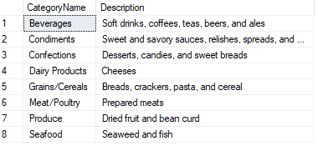
2. Certain fields from Categories
SELECT CategoryName, Description
from
[dbo].[Categories]

Slide 6
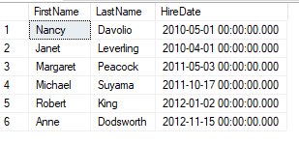
3. Sales Representatives
Select FirstName, LastName, HireDate
from Employees
where Title='Sales Representative'

Slide 7

4. Sales Representatives in the United States
Select FirstName, LastName, HireDate
from Employees
where Title='Sales Representative' and Country='USA'

Slide 8
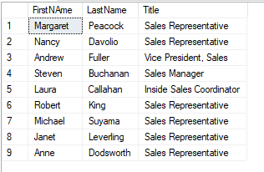
5. Employees, in order of age
select FirstNAme, LastName,Title from [dbo].[Employees]
order by BirthDate ASC;

Slide 9
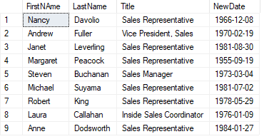
6. Showing only the Date with a DateTime field
select FirstNAme,LastName,Title, cast (BirthDate As Date) As NewDate
from [dbo].[Employees]

Slide 10
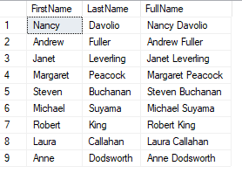
7. Employees full name
Select FirstName, LastName, FirstName+' '+LastName As FullName
from Employees

Slide 11

8. How many customers?
select count(*) as TotalCustomers from [dbo].[Customers];

Slide 12

9. When was the first order?
select min(OrderDate) as FirstOrder from [dbo].[Orders];

Slide 13
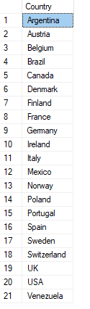
10. Countries where there are customers
select distinct Country
from [dbo].[Customers]

Slide 14
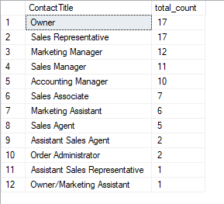
12. Contact titles for customers
select ContactTitle, count(*) as total_count
from Customers
group by contactTitle
order by total_count desc;

Slide 15
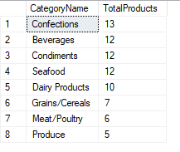
13. Categories, and the total products in each category
SELECT C.CategoryName,count(*) AS TotalProducts
FROM Categories AS C
INNER JOIN [dbo].[Products] AS P
ON C.CategoryID=P.CategoryID
group by C.CategoryName
ORDER BY TotalProducts desc

Slide 16

14. Products that need reordering
Select productId, ProductName, unitsInStock, ReorderLevel
from Products
where unitsInStock<ReorderLevel;

Slide 17

15. Products that need reordering, continued
select ProductId, ProductName, UnitsInStock, UnitsOnOrder, ReorderLevel, Discontinued
from Products
where UnitsInStock, UnitsOnOrder <= ReorderLevel and Discontinued = 0
Order by ProductId;

Slide 18

16. High freight charges
select top 3 ShipCountry, avg(Freight) as AverageFreight from [dbo].[Orders]
group by ShipCountry
order by AverageFreight desc;

